Slide 1
Redbit Workshop
Software Design Principles and Unit Test
Thursday 21 December 2017

Slide 2
SOLID
The term SOLID is an acronym for five design principles intended to make software designs more understandable, flexible and maintainable.

Slide 3
And this is good for... ?
Easy to maintain, adapt and adjust to scope changes;
Testable and easy to understand;
Extensible for changes with minimal effort;
Provide maximum reuse;
Stay as long as possible in use;
Avoid code duplication;
Avoid weak code;
Notes:
Weak code – easily breaks after any changes (butterfly effect)

Slide 4
SOLID
"S" ingle responsibility
"O" pen closed
"L" iskov substitution
"I" nterface segregation
"D" ependency inversion
Notes:
Single Responsibility – A module should have one, and only one reason to change. The most important principle. All the other principles depends on it. Example: a class that compiles and prints a report. The content of the report could change and also the report format could change.
Open closed – A module should be open for extension, but closed for modification. Example: a method to include a spent on a bank account (checking, savings, investment)
Liskov substitution – If S is a subtype of T, then objects of type T may be replaced with objects of type S without altering any of desirable properties of T.
Interface segregation – No client should be forced to depend on methods it does not use. Example: an interface with include, validate and sendEmail methods. We can implement for a Customer Include class, but not for a Item Include class.
Dependency inversion – High-level modules should not depend on low-level modules. Both should depend on abstraction

Slide 5

Single responsibility
“A class should have one, and only one, reason to change”
Notes:
This is the main principle. Every other principles depends on it. Switchblade

Slide 6

Open closed
“Software entities (classes, modules, functions, etc) should be open for extensions, but closed for modification”
Notes:
It’s linked to the SRP. If the single responsibility is done, the class can’t be changed (unless for maintenaince)

Slide 7
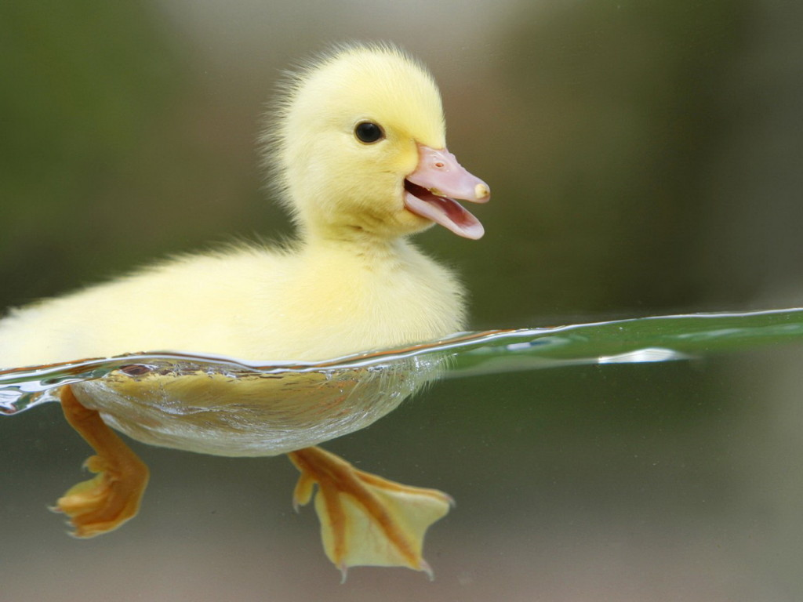

Liskov substitution
“A base class can be replaced by your derived class”
Notes:
If swim like a duck, fly like a duck, but needs battery, you have an abstraction issue.

Slide 8

Interface segregation
“No client should be forced to depend on methods it does not use”
Notes:
Lots of interfaces are better than a unique

Slide 9
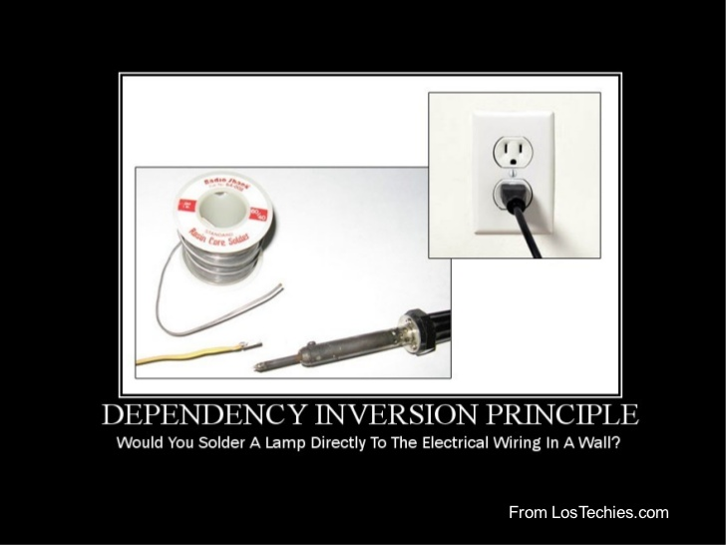
Dependency inversion
“High-level modules should not depend on low-level modules. Both should depend on abstractions. Abstractions should not depend on details. Details should depend on abstractions.”
Notes:
Abstract without implement. You can use dependency INJECTION (a code strategy) in order to implement the dependency INVERSION (an architectural design) principle

